Slide 1
Presentation 26
The SQA unit and other
actors in the SQA system
The SQA unit
  Tasks performed by the head of the SQA unit
  SQA sub-unit tasks related to the project life cycle
  SQA sub-unit infrastructure operations tasks
  SQA sub-unit audit and certification tasks
  SQA sub-unit support tasks
  SQA sub-unit standards and procedures: Development and maintenance tasks
  SQA sub-unit information system tasks
SQA trustees and their tasks
SQA committees and their tasks
SQA forums — tasks and methods of operation

Slide 2
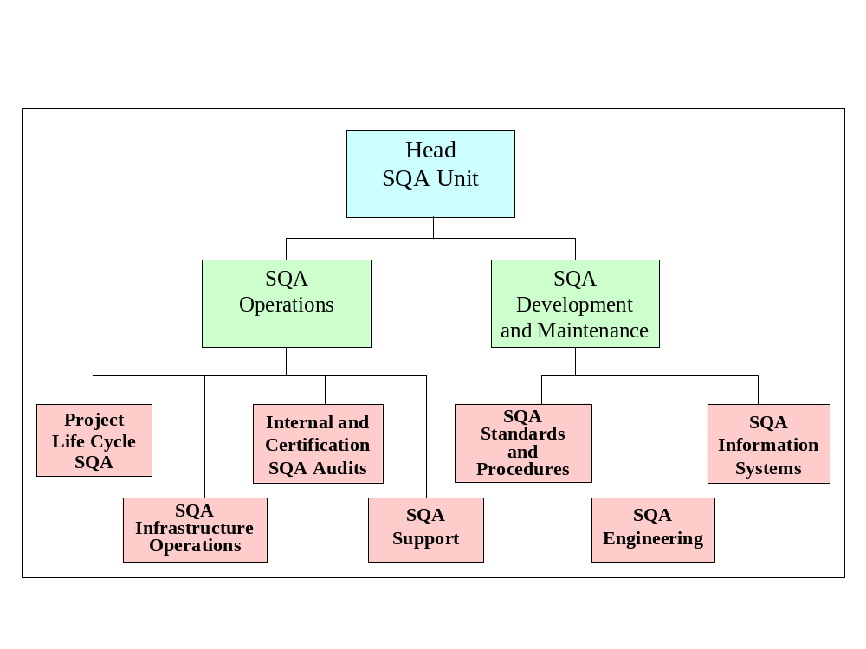
Proposed model for an SQA
Unit’s organizational structure

Slide 3
Tasks performed by
the head of the SQA unit (1)
Planning tasks
Preparation of proposals for the Unit’s annual activity program and budget
Planning and updating the organization’s software quality management system and recommended annual SQA activities programs for the software development and maintenance departments.
Preparation of recommended SQA systems development plans for the software development and maintenance departments.
Management tasks
Management of SQA team's activities
Monitoring implementation of the SQA activity program
Nomination of team members, SQA committee members and SQA trustees
Preparation of special and periodic status and performance reports.

Slide 4
Tasks performed by
the head of the SQA unit (2)
Contacts with customers and other external bodies and the executive in charge of software quality
Serving as the customer’s address for software quality issues of software products and services supplied
Representation of the organization before external bodies regarding software quality issues
Drafting the management review reports
Raising SQA organizational issues and preparing requested material for top management's consideration
SQA professional activities
Participation in project joint committees
Participation in formal design reviews
Review and approval of deviations from specifications
Consultation to project managers and team leaders
Participation in SQA committees and forums

Slide 5
SQA sub-unit tasks
related to the project life cycle
Project life cycle control tasks
Follow up of development and maintenance teams’ compliance with SQA procedures and work instructions
Approval or recommendation of software products (design reports and code).
Monitoring delivery of software maintenance services to internal and external customers
Monitoring customer satisfaction (surveys, etc.) and maintaining contact with customer’s SQA representatives
Participation tasks participation in:
Contract reviews
Preparation and updating of project development and project quality plans
Formal design reviews
Subcontractors’ formal design reviews
Software testing, including customer acceptance tests
Software acceptance tests of subcontractors’ software products
Installation of new software products

Slide 6
SQA sub-unit
infrastructure operations tasks
Publication of updated versions of procedures, work instructions, templates, checklists, etc., with their circulation.
Training and instruction to new and current staff and SQA trustees regarding SQA procedures, work instructions, new and revised procedures, development tools and methods, etc.
Monitoring and supporting implementation of new and revised SQA procedures
Follow up of staff certification activities
Proposal of subjects requiring preventive and corrective actions, including participation in CAB committees
Follow up of configuration management activities, including participation in CCA committees
Follow up of compliance with documentation procedures and work instructions

Slide 7
SQA sub-unit
infrastructure operations tasks
Publication of updated versions of procedures, work instructions, templates, checklists, etc., and their circulation
Transmission of training and instruction regarding application of SQA procedures, work instructions and similar items to new and current staff
Instruction of SQA trustees regarding new and revised procedures, development tools and methods, etc.
Monitoring implementation of new and revised SQA procedures
Follow up of staff certification activities
Proposal of preventive and corrective actions, including participation in CAB committees
Follow up of configuration management activities, including participation in CCA committees
Follow up of compliance with documentation procedures and work instructions

Slide 8
Types of SQA audits
carried out in or by
software organization
Internal audits
Audits of subcontractors and suppliers to evaluate their SQA systems
External audits performed by certification bodies
External audits performed by customers who wish to evaluate the SQA system prior to accepting the organization as a supplier

Slide 9
SQA sub-unit audit and certification tasks
SQA sub-unit audit
and certification tasks
Preparation of annual programs for SQA audits
Performance of SQA audits
Follow up of corrections
Preparation of periodic summary reports
Collection of data on the performance of the audited organization from internal and external sources
Periodic evaluation of the audited organization
Coordination of the external audit's contents and schedule
Preparation of documents as specified by external auditors
Instruction of the audited teams and performance of preparations for external audits
Participation in the audit

Slide 10
SQA sub-unit support tasks
SQA sub-unit support tasks
Preparation of project development plans and project quality plans
Staffing review teams
Choice of development methodologies and tools that reflect the accumulated failure experience
Choice of measures to solve identified software development risks
Choice of measures to solve schedule delays and budget overruns
Choice of SQA metrics and software costs components
Use of SQA information systems

Slide 11
SQA sub-unit
standards and procedures
development and maintenance tasks
Prepare an annual program for development of new procedures and procedure updates
Responsibility for development of new procedures and procedure updates, including participation in appropriate committees and forums
Follow up of developments and changes in SQA and software engineering standards; introduction of additional relevant procedures and changes
Initiation of updates and adaptations of procedures in response to changes in professional standards, including adoption or deletion of standards applied by the organization.

Slide 12
SQA sub-unit
engineering development
and maintenance tasks
Testing quality and productivity aspects with respect to new development tools and new versions of currently used development tools
Evaluation of quality and productivity of new and improved development and maintenance methods
Development of solutions to difficulties confronted in application of currently used software development tools and methods
Development of methods for measuring software quality and team productivity
Provision of technological support to CAB committees during analysis of failures and formulation of solutions

Slide 13
SQA sub-unit
information system tasks
Development of SQA information systems for software development and maintenance units for:
  Collection of activity data.
  Processing of information delivered by the units: periodic reports, lists, exception reports, queries and estimates of software quality metrics and software quality costs.
Updating of SQA information systems
Development and maintenance of the organization's SQA Intranet/Internet site

Slide 14
SQA trustees and their tasks
SQA trustees and their tasks
Unit-related tasks:
Support their colleagues' attempts to solve difficulties in the implementation of SQA procedures and work instructions
Help their unit manager in performing his or her SQA tasks Promote compliance and monitor implementation of SQA procedures and work instructions by colleagues
Report substantial and systematic non-compliance events to the SQA unit
Report severe software quality failures to the SQA unit
Organization-related tasks
Initiate changes and updates of organization-wide SQA procedures and work instructions
Initiate organization-wide improvements of development and maintenance processes and applications to the CAB for solutions to recurrent failures observed in their units
Identify organization-wide SQA training needs and propose an appropriate training or instruction program

Slide 15
SQA committees
and their tasks
Permanent committees commonly deal with:
  SCC (software change control),
  CA (corrective actions),
  Procedures,
  Development of method, tools and quality metrics.
Ad-hoc committees commonly deal with specific cases:
  Updates of a specific procedure,
  Analysis and solution of a software failure,
  Elaboration of software metrics for a targeted process or product,
  Updating software quality costs,
  Data collection methods for a specific issue.

Slide 16
SQA forums — tasks
SQA forums typically focus on:
SQA procedures improvements and implementation
Quality metrics
Corrective actions – analysis of failure and success cases
Quality system issues – development and implementation of new tools
Quality line management problems – daily operational software quality problems

Slide 17
SQA forums — participants
Members of an open forum may include:
SQA unit members
SQA trustees
Software development and maintenance staff
SQA and software engineering consultants/experts
Customer representatives

